Slide 1
Project title: Smart health care system using IOT
Under the Guidance of: Dr Madhava Rao sir
BY
G.Bhavana
2401600173
dept.mca

Slide 2
Problem statement:
In traditional healthcare systems, patient vital signs such as heart rate, oxygen saturation (SpO₂), and body temperature are often monitored manually or using standalone devices. This approach does not support continuous monitoring, remote access, or real-time alerts, which can delay medical response during emergencies.
Existing Issues / Limitations:
Health data is not monitored continuously
No real-time alerts during emergencies
Traditional systems are not cloud-integrated
Problem Needs a Solution:
Remote monitoring reduces hospital workload
Cloud storage allows real-time data access
Useful for elderly care and rural healthcare

Slide 3
SCOPE OF PROJECT:
Continuous monitoring of:
Heart Rate
SpO₂ (Blood Oxygen Level)
Body Temperature
Data collection using ESP32 & sensors
Real-time data upload to Firebase Cloud
Live display of health data on a web dashboard

Slide 4
What Is NOT Included:
Medical diagnosis or treatment suggestions
Emergency alert system (SMS / Call)
Advanced AI or machine learning predictions
Hospital management or appointment systems

Slide 5
Target Users:
Elderly users
Patients and doctors
Healthcare students

Slide 6
Proposed Solution:
Overview of the Solution:
The Smart Health Care Monitoring System is a cloud-based web application that continuously collects patient health parameters such as heart rate, SpO₂, and body temperature and displays them on a real-time dashboard.
By using Firebase Realtime Database, the system ensures instant data updates, enabling timely monitoring and faster medical response.
Key Features:
Real-time display of Heart Rate, SpO₂, and Temperature
Cloud-based data storage using Firebase
Secure login and registration system
User-friendly and responsive web dashboard

Slide 7
Innovation / Uniqueness:
Uses real-time cloud technology instead of manual health tracking
Enables remote patient monitoring from anywhere

Slide 8
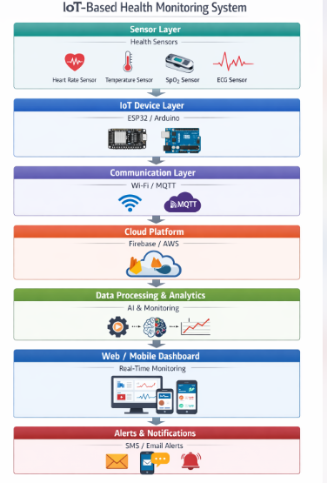
System Articheture:

Slide 9
Components Explanation
Health Sensors
Collect vital parameters:
Heart Rate
SpO₂
Body Temperature
IoT Device (ESP32 / Arduino)
Reads sensor values
Sends data to Firebase using Wi-Fi
Firebase Realtime Database
Stores patient health data
Provides real-time updates instantly

Slide 10
Technologies Used:
Frontend:
HTML
CSS
JavaScript
Backend
Firebase Realtime Database
Firebase Authentication
Database
Firebase Realtime Database (Cloud-based)
Tools & Libraries
Firebase SDK
Visual Studio Code
Web Browser

Slide 11
Module 1: User Authentication & Profile Management
Handles user registration and login (patients/doctors/admin).
Stores user details securely in the database.
Ensures authorised access to the system using authentication mechanisms.
Manages user roles and basic profile information.
Module 2: Health Data Monitoring & Collection
Collects real-time health parameters such as heart rate, temperature, and oxygen levels.
Receives data from sensors / IoT devices (or manual input for testing).
Stores health data in the cloud database (Firebase).
Continuously updates patient health records.
Module 3: Dashboard, Alerts & Data Visualisation
Displays real-time health data on an interactive dashboard.
.

Slide 12
Implementation Status:
User Interface
Real-time Health Data Display
Firebase Realtime Database Integration
Live data fetching and UI updates
40% project status

Slide 13
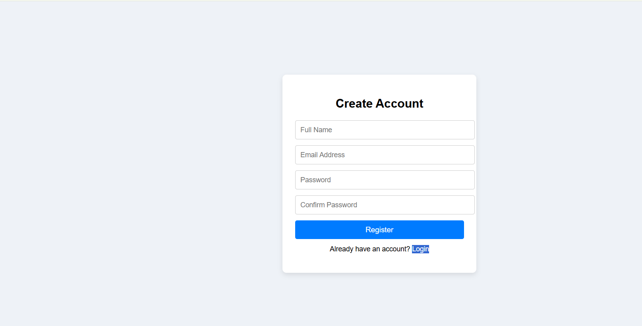
Registration page:

Slide 14
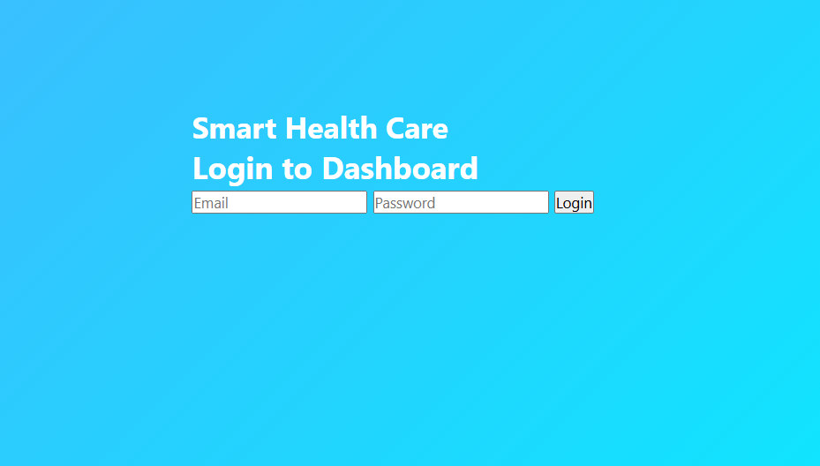
Login page:

Slide 15
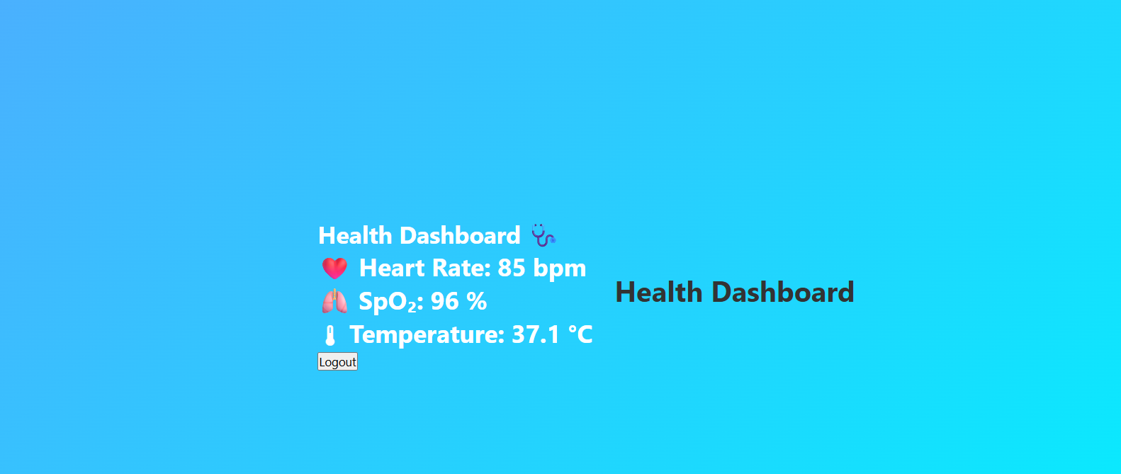
Dashboard page:

Slide 16
Conclusion:
Project Summary:
The Smart Health Care Monitoring System provides a reliable and efficient solution for monitoring patient health remotely.
It integrates real-time data collection, cloud storage, and web-based dashboards for continuous health tracking.
The system improves healthcare accessibility by enabling remote monitoring and quick response to critical health conditions.
Cloud-based architecture ensures scalability, security, and easy data management.
Achievements:
Successfully designed and implemented a real-time health monitoring dashboard.
Achieved secure user authentication and data storage using Firebase.

Slide 17
THANKYOU

